Slide 1

Predicting Student’s Academic Performance using Machine Learning
By ,
Gilbert raj v

Slide 2
Abstract
Students face various challenges affecting their academic performance, including time management, procrastination, stress, financial issues, health problems, motivation, and inadequate resources.
Academic challenges may also encompass issues related to teacher quality, cultural adjustment, language barriers, unrealistic expectations, and peer pressure, which can impact students' ability to excel in their studies.
These challenges can be addressed through improved study habits, support systems, and effective coping strategies.
To overcome academic challenges, students can employ strategies like time management, seeking support, financial planning, mental health care, resisting peer pressure, utilizing technology wisely, and maintaining a healthy lifestyle.

Slide 3
Abstract
Predicting a student's academic performance is a complex task that involves several factors, including past academic performance, attendance, learning style, home environment, motivation, personality traits, and social and economic background.
We predict university dropout using random forests based on conditional inference trees and on a broad German data set covering a wide range of aspects of student life and study courses.
Important predictors are the final grade at secondary school, and also determinants associated with student satisfaction and their subjective academic self-concept and self-assessment.

Slide 4
Introduction
The goal of this project is to develop a predictive model that can accurately predict a student's academic performance based on various factors such as their background, study habits, motivation, and socio-economic status.
By predicting a student's future academic success, we aim to create personalized learning plans and provide additional support to struggling students to improve overall academic performance and reduce the achievement gap.
To accomplish this goal, we will use machine learning algorithms and data analytics techniques to analyze the student data.

Slide 5
Literature Survey
Predicting School Failure and Dropout by Using Data Mining Techniques Author: Carlos Márquez , Cristóbal Romero Year : 2018
In this research, data mining is used to predict school failure and dropout among 670 middle-school students in Zacatecas, México. The study explores different methods to improve accuracy, including using all attributes, selecting the best ones, and adjusting for data imbalances. The most effective models are highlighted.
Title: Study of Factors Analysis Affecting Academic Achievement of Undergraduate Students in International Program : Author: Pimpa Cheewaprakobkit Year: 2019
This study aims to figure out what factors impact students' academic success. Using a tool called WEKA, the researcher analyzed data from 1,600 international program students at a Thai university. They compared Decision Tree and Neural Network classifiers and found Decision Tree to be 1.313% more accurate at predicting academic performance, with an 85.188% accuracy rate.

Slide 6
Literature Survey
Title: A combinational incremental ensemble of classi fiers as a technique for predicting students’ performance in distance education Author : S. Kotsiantis, K. Patriarcheas Year: 2019
Predicting student performance in online learning is essential. This study recommends an online ensemble of classifiers, including Naive Bayes, 1-NN, and WINNOW algorithms, to enhance accuracy. The proposed approach is suitable for a support tool. Keywords: online learning, machine learning, ensemble classifiers, Naive Bayes, 1-NN, WINNOW, support tool.
Title: Drop Out Feature of Student Data for Academic Performance Using Decision Tree Techniques Author: Mr. M. N. Quadri1 Year: 2019
This study focuses on using data mining to predict students who might drop out from college. They use a decision tree technique to make these predictions based on students' academic performance (measured by CGPA). These predictions are then used for intervention by teachers and management to help at-risk students.

Slide 7
Objective
The project could involve collecting and analyzing relevant data using statistical methods, developing and testing predictive algorithms, and creating personalized learning plans and interventions based on the insights gained from the predictive model.
When there are a large number of attributes, some of them may not be meaningful for classification and it is likely that some of the attributes may be correlated.
The number of student dropout from the educational institute is increasing day by day.
This is an educational data set which is collected from learning management system (LMS) called Kalboard 360. Kalboard 360 is a multi-agent LMS, which has been designed to facilitate learning through the use of leading-edge technology.

Slide 8
Methodology
Data Collection and Preprocessing
Gather diverse educational data encompassing student grades, demographics, and academic performance records.
Perform data preprocessing by eliminating duplicates, handling missing values, and converting categorical attributes into numerical formats.
Feature Selection and Transformation:
Employ techniques like Recursive Feature Elimination with Cross-Validation (RFECV) to identify influential features.
Normalize and scale selected features to ensure uniformity for machine learning model integration.

Slide 9
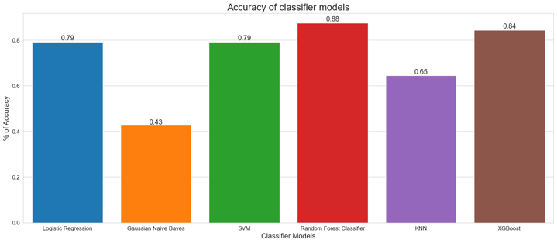
Methodology
Model Selection and Training:
Utilize various machine learning algorithms like Logistic Regression, Random Forest Classifier, Gaussian Naive Bayes, SVM, KNN, and XGBoost.
Assess each algorithm's performance and select the most suitable model (e.g., Random Forest Classifier) based on accuracy and efficiency.

Slide 10
Methodology
Random Forest
Random forest is a commonly-used machine learning algorithm which combines the output of multiple decision trees to reach a single result. Its ease of use and flexibility have fueled its adoption, as it handles both classification and regression problems.
This randomness helps in creating diverse trees, reducing overfitting and improving generalization.
It's known for its robustness, ability to handle large datasets with high dimensionality, and resistance to overfitting compared to individual decision trees.

Slide 11
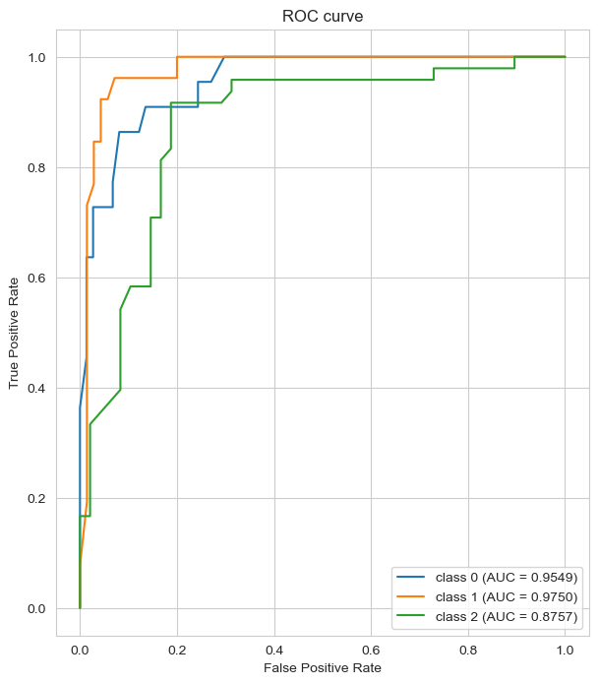
Results
The model excels in differentiating Class 0 and Class 1 instances, but its performance is slightly less robust for Class 2.

Slide 12
Results
For Low-Level Grades (0-69):
1. Personalized Support: Implement individualized tutoring or mentoring sessions to address specific learning gaps.
2. Targeted Interventions: Offer remedial classes focusing on fundamental concepts to strengthen foundational knowledge.
3. Enhanced Feedback Mechanisms: Provide detailed feedback on assignments and assessments to identify weaknesses and offer guidance for improvement.
4. Supportive Learning Environment: Foster a supportive classroom atmosphere encouraging questions and fostering confidence in struggling students.

Slide 13
Results
For Middle-Level Grades (70-89):
1. Enrichment Programs: Offer advanced coursework or extracurricular activities to challenge and engage students beyond the standard curriculum.
2. Continuous Assessment: Implement regular assessments to monitor progress and identify areas needing improvement.
3. Individual Goal Setting: Encourage students to set personal academic goals, providing motivation and direction for improvement.
4. Peer Collaboration: Facilitate collaborative learning environments where students can work together, enhancing their understanding and skills.

Slide 14
Results
For High-Level Grades (90-100):
1. Advanced Projects or Research: Provide opportunities for independent projects or research to stimulate intellectual curiosity and challenge high-performing students.
2. Mentorship and Guidance: Connect high-achieving students with mentors or resources to explore their academic interests further.
3. Differentiated Learning: Offer differentiated tasks or activities to prevent boredom and keep students engaged.
4. Encourage Critical Thinking: Promote higher-order thinking skills through problem-solving activities and discussions to deepen understanding and application of knowledge.

Slide 15
Future Scope
Real-time Implementation: Adapt models to work in real-time scenarios, providing instant predictions and adaptive learning capabilities.
Continuous Evaluation: Implement monitoring systems to track algorithmic performance over time, allowing for adjustments and improvements as needed.
Ensemble Techniques: Combine top-performing models to create a more robust and accurate predictive system.

Slide 16
THANK YOU

